Slide 1
RTandCasKinetics:
Maya Singh

Slide 2
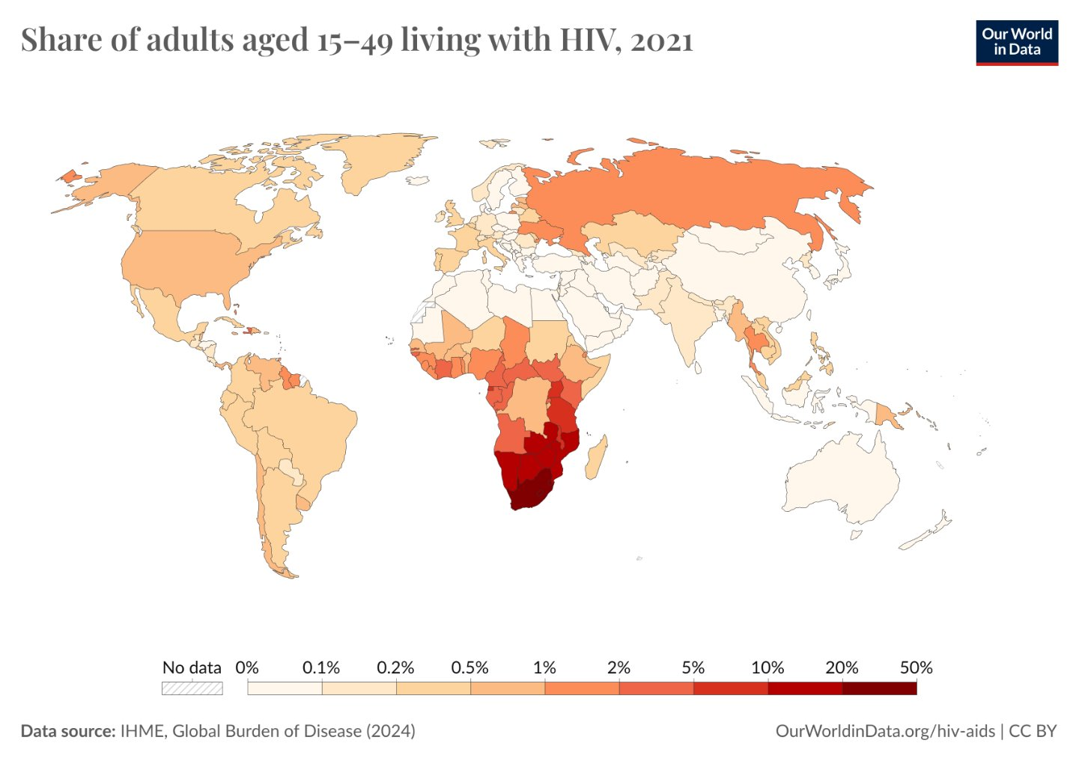
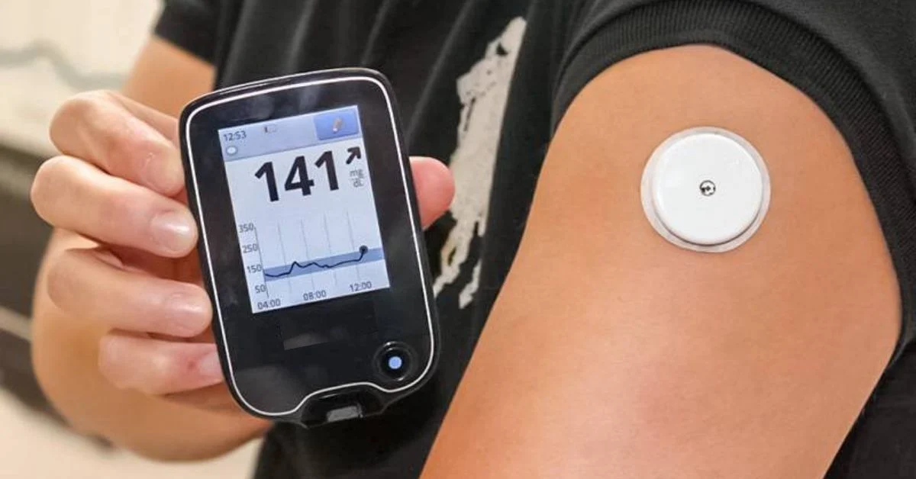
Drug monitoring can help reduce HIV burden – 40 mil. people living with HIV
Glucose monitors ensure people maintain certain levels

Slide 3
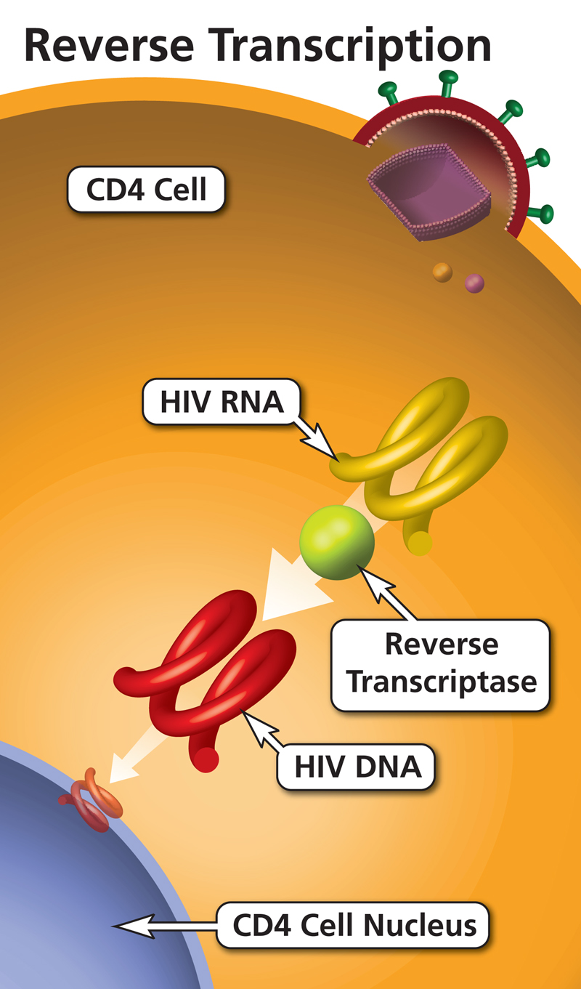
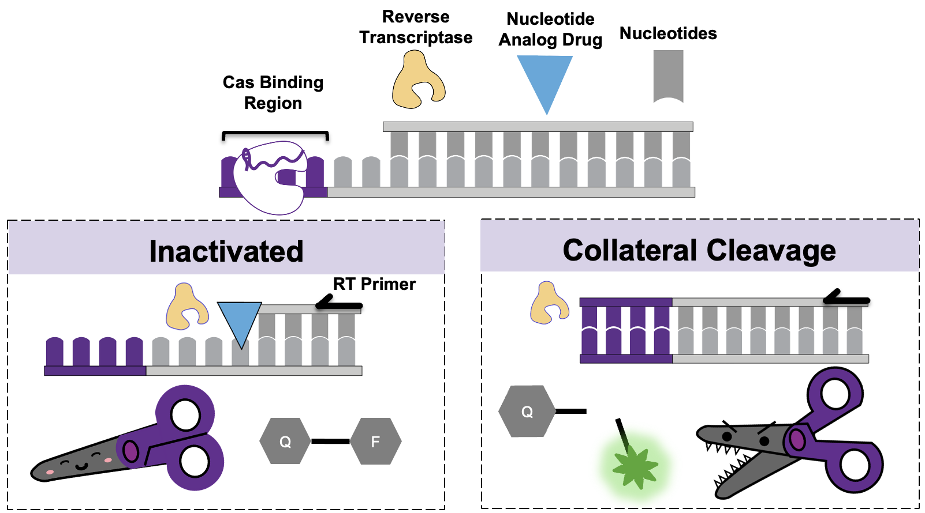
HIV reverse transcriptase and CRISPR cas12a kinetics are not well characterized
Figure made by Carrie Lin
Reverse transcriptase (RT) is a target for HIV medication
CRISPR Cas12a can do collateral cleavage to generate fluorescence

Slide 4
Problem Statement
No current tools exist that investigate the combined kinetics of reverse transcriptase and CRISPR Cas12a
Real-time curves allow for better understanding of clinical values of medication within the body
How can we model the real-time curves to avoid unnecessary experiments?

Slide 5
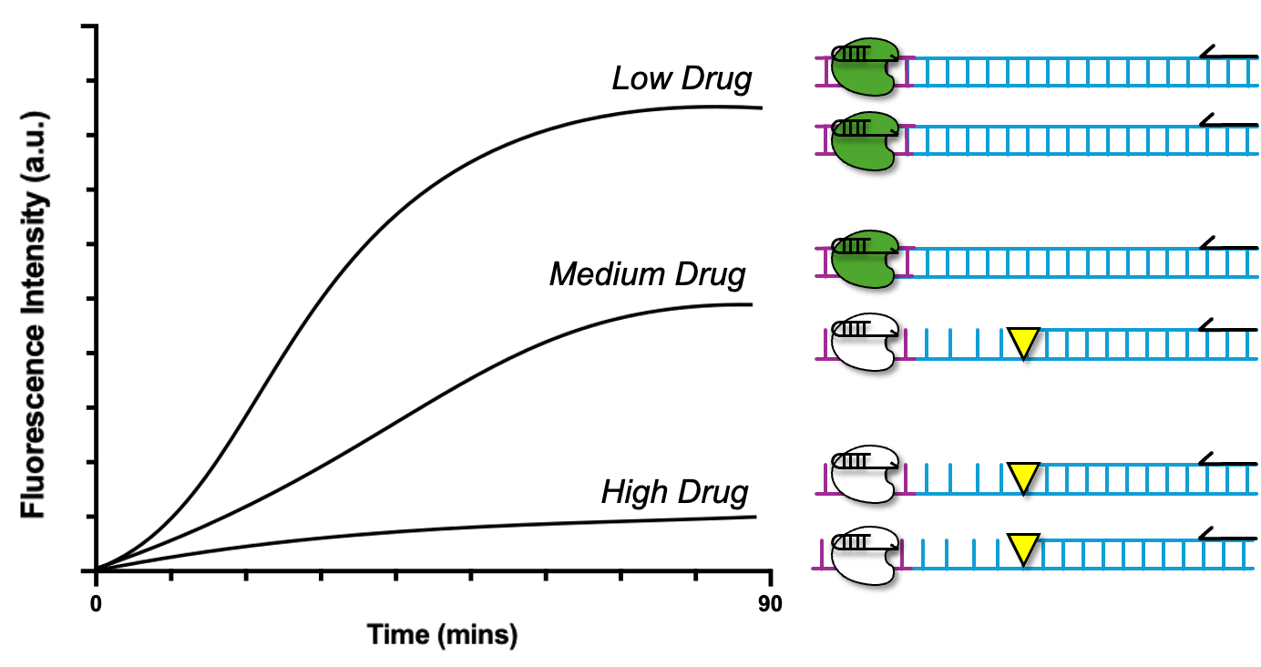
Use Cases
USERS:
Researchers interested in investigating combined kinetics of RT and Cas12a.
Users do not need any python experience
USE CASE:
To create real-time fluorescence curves based on input parameters
Nucleotide, primer, template concentrations
DNA template sequence
Investigate kinetics for various drug concentrations

Slide 6
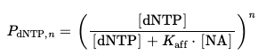
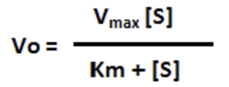
Project Overview
Open program
Use PDM
Casmodel()
GUI - PyQT
Casmodel_func()
Inputs:
DNA, [dNTP], [Template], [Primer]
Probability_func() for reverse transcriptase
Primer Diffusion for time delay
Tellurium: Use Michaelis Menten for Cas12a
[NA]: Nucleotide Analog

Slide 7
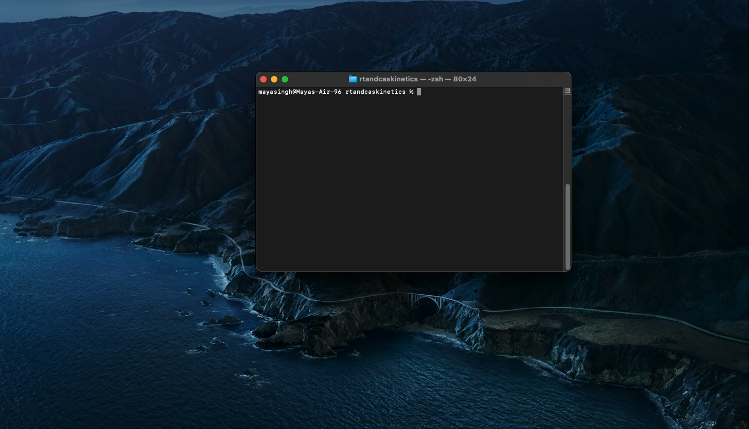
Demonstration of Project

Slide 8
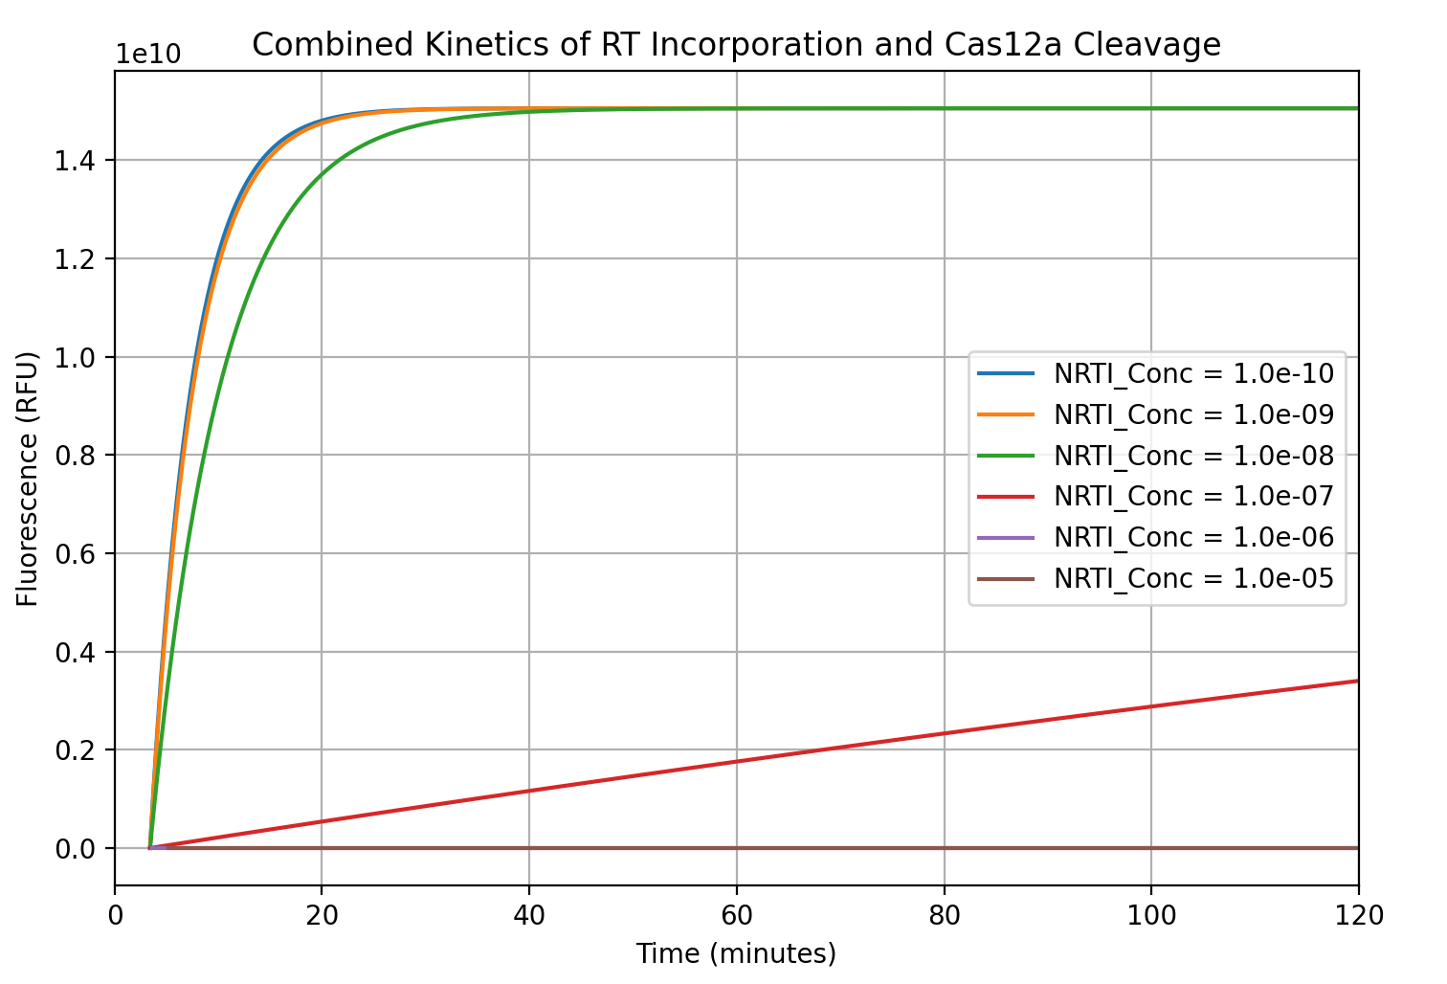
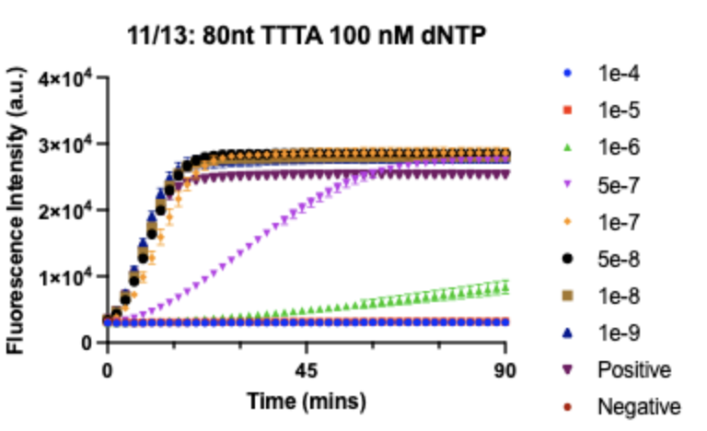
Lessons Learned
Writing and thinking of tests is more challenging than expected
Learning how to interface with Github
Learning how to create a package is very difficult but useful!

Slide 9
Next Steps
Investigate more accurate kinetics for CRISPR Cas12a
Investigate other time delay aspects
Iterate with feedback from lab mates who would use this function

Slide 10
HIV is still a global epidemic – 39.9 million people are living with HIV
Reasons for High Prevalence of HIV
Inaccessibility of treatment
Cost of treatment
Inadequate drug levels

Slide 11
Background. (10 pt) This is the material needed to describe the problem addressed by the paper.
Problem statement. (10 pt) What research question is addressed?
Methodology. (30 pt) What was their experimental design? Their model? Their approach to parameter estimation? Their analysis of the data? Software design issues.
Results. (20 pt) Summarize their results as they pertain to the research question.
Challenges/Issues. (30 pt) Based on the techniques developed in this course, what were the shortcomings of the paper?

